Slide 1
Sustainable Construction

Slide 2
Entities
Dwelling
Water
Energy

Slide 3
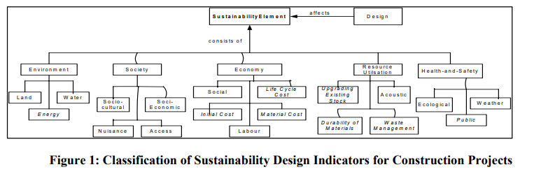

Slide 4
Dwelling
cheap, comfortable and durable dwelling
Vernacular Architecture
Traditional Architecture
Hybrid Architecture
Heat modulation
thermal insulation

Slide 5
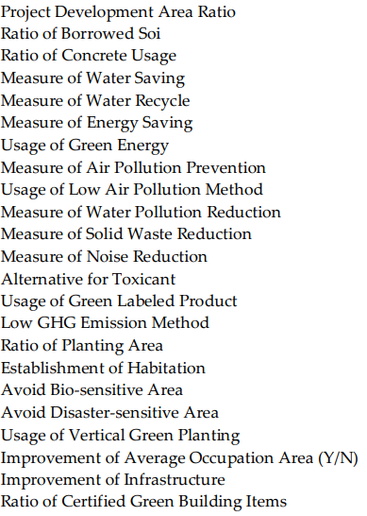
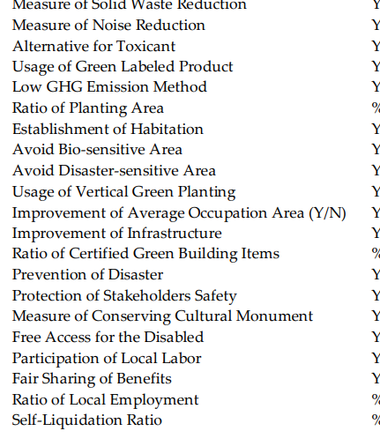

Slide 6
https://www.sciencedirect.com/science/article/pii/S221260901730078X
file:///C:/Users/Jacob/Desktop/video%20meu/pesquisa/Ugwu-TaxonomyforSUSAIP.pdf
https://www.mdpi.com/sustainability/sustainability-10-01523/article_deploy/html/images/sustainability-10-01523-g003.png
file:///C:/Users/Jacob/Desktop/video%20meu/pesquisa/sustainability-10-01523-s001.pdf

